Slide 1


David Taylor
9/17/2025

Slide 2

Outline
Executive Summary
Introduction
Methodology
Results
Conclusion
Appendix

Slide 3
Executive Summary
Collected data via SpaceX API
Cleaned and filtered data for Falcon 9 rockets
Summary of all results

Slide 4
Introduction
Project background and context
Determine the price of each launch
Build a model to predict whether a launch will be successful, ie whether stage 1 of rocket will land and can be reused.

Slide 5

Section 1

Slide 6
Methodology
Executive Summary
Data collection methodology:
Data was retrieved via SpaceX API
Data was webscraped
Perform data wrangling
Missing values were filled
Data was filtered
Perform exploratory data analysis (EDA) using visualization and SQL
Perform interactive visual analytics using Folium and Plotly Dash
Perform predictive analysis using classification models
Classification model (success/lanede

Slide 7
Data Collection
Describe how data sets were collected.
SpaceX API
Webscraping
You need to present your data collection process use key phrases and flowcharts

Slide 8
Data Collection – SpaceX API
Initial API call to get launch data
Subsequent API calls to get Rocket Core, Booster, Launch Site and Payload data.
Merge associated data from all calls to to a single data point
Github link: https://github.com/codewizard-dt/ibm-datascienc-capstone/blob/main/jupyter-labs-spacex-data-collection-api-v2.ipynb
Get Launch Data
Get Core/Booster/Site/Payload Data
Merge data

Slide 9
Data Collection - Scraping
SpaceX Launch Wiki Link was scraped
Table with launch data identified and parsed
Columns and variable names extracted
Added all data to data frame
Github URL: https://github.com/codewizard-dt/ibm-datascienc-capstone/blob/main/jupyter-labs-webscraping.ipynb
Website parsed with BeautifulSoup
Extract columns, var names
Create data frame

Slide 10
Data Wrangling
Describe how data were processed
You need to present your data wrangling process using key phrases and flowcharts
Add the GitHub URL of your completed data wrangling related notebooks, as an external reference and peer-review purpose

Slide 11
EDA with Data Visualization
Flight Number vs Launch Site, scatterplot
Flight Number vs Payload Mass, scatterplot
Payload Mass vs Launch Site, scatterplot
Average Success by Orbit, bar chart
Flight Number vs Orbit, scatterplot
Payload Mass vs Orbit, scatterplot
Average Success by Year, line chart
Github URL: https://github.com/codewizard-dt/ibm-datascienc-capstone/blob/main/jupyter-labs-eda-dataviz-v2%20(1).ipynb

Slide 12
EDA with SQL
Names of the unique launch sites
5 records where launch site starts with CCA
Total payload mass carried by boosters launched by NASA (CRS)
Average payload mass carried by booster version F9 v1.1
Date when the first successful landing outcome in ground pad was achieved
Names of the boosters which have success in drone ship and have payload mass greater than 4000 but less than 6000
Total number of successful and failure mission outcomes
"booster_versions" that have carried the maximum payload mass
Records showing month, landing outcome, booster version and site for 2015
Landing outcomes and their totals between the date 2010-06-04 and 2017-03-20
Github URL: https://github.com/codewizard-dt/ibm-datascienc-capstone/blob/main/jupyter-labs-eda-sql-coursera_sqllite.ipynb

Slide 13
Build an Interactive Map with Folium
Added markers for Launch site locations
Github URL: https://github.com/codewizard-dt/ibm-datascienc-capstone/blob/main/lab-jupyter-launch-site-location-v2.ipynb

Slide 14
Build a Dashboard with Plotly Dash
Add a dropdown list to enable Launch Site selection
Add a pie chart to show the total successful launches count for all sites (or if a site is selected then show successful/failed launches
Add a slider to select payload range (to filter the data)
Add a scatter chart to show the correlation between payload and launch success
Github URL: https://github.com/codewizard-dt/ibm-datascienc-capstone/blob/main/spacex-dash-app.py

Slide 15
Predictive Analysis (Classification)
Separate X and Y
Standardize X using StandardScaler
Split into train/test (test_size = 0.2)
GridSearchCV for the following models
LogisticRegression, SupportVectorMachine, DecisionTreeClassifier, KNeighbors,
Evaluated the confusion matrix and accuracy scores for each "best model" for both training and test data
Github URL: https://github.com/codewizard-dt/ibm-datascienc-capstone/blob/main/SpaceX-Machine-Learning-Prediction-Part-5-v1.ipynb
Prepare/Standardize data
Split into training/test groups
Run GridSearch for each model type
Compare "best models"

Slide 16
Results
Exploratory data analysis results
Interactive analytics demo in screenshots
Predictive analysis results

Slide 17

Section 2

Slide 18
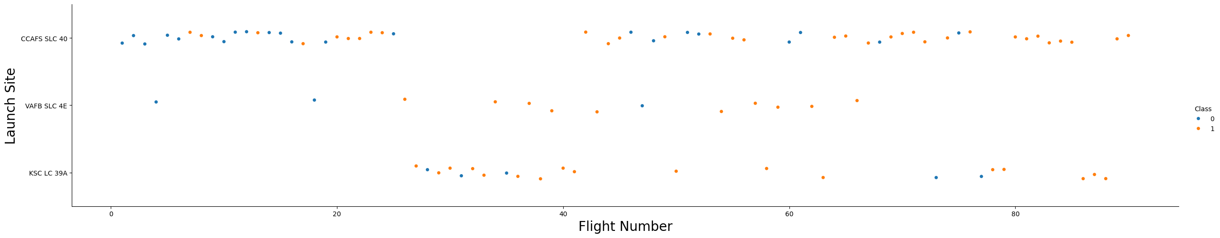
Flight Number vs. Launch Site
Blue = failure, orange = success
Launch site 'VAFB' had higher success compared to others, but also fewer launches

Slide 19
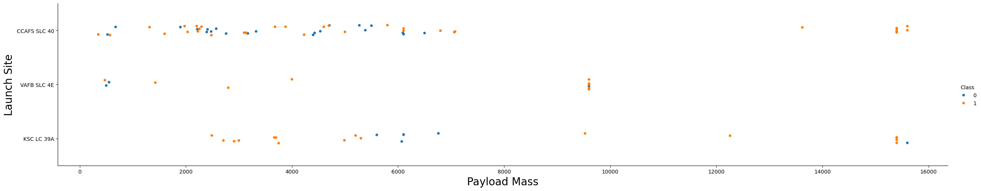
Payload vs. Launch Site
Blue = failure, orange = success
Only 2 out of 3 launch sites had large payloads
Large payloads had higher success rates

Slide 20
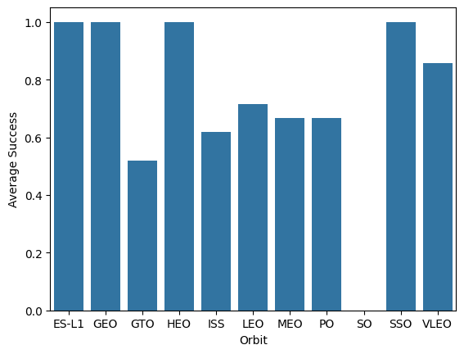
Success Rate vs. Orbit Type
SO orbit had all failures
ES-L1, GEO, HEO, SSO had all successes
6 out of 11 orbits had mixed success

Slide 21
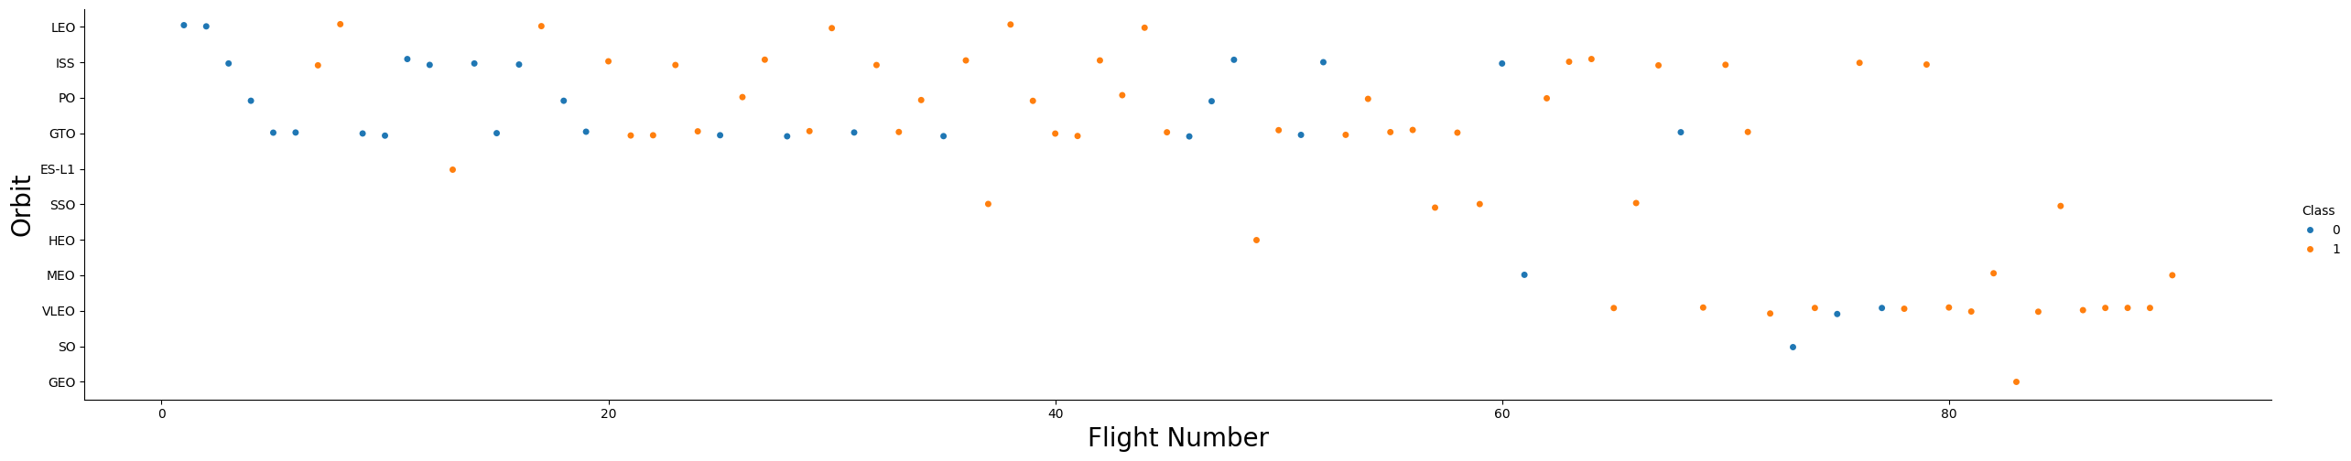
Flight Number vs. Orbit Type
Blue = failure, orange = success
Earlier flights were less successful, while later flights more successful
VLEO, MEO, HEO, SSO, GEO were only tried for later flights

Slide 22
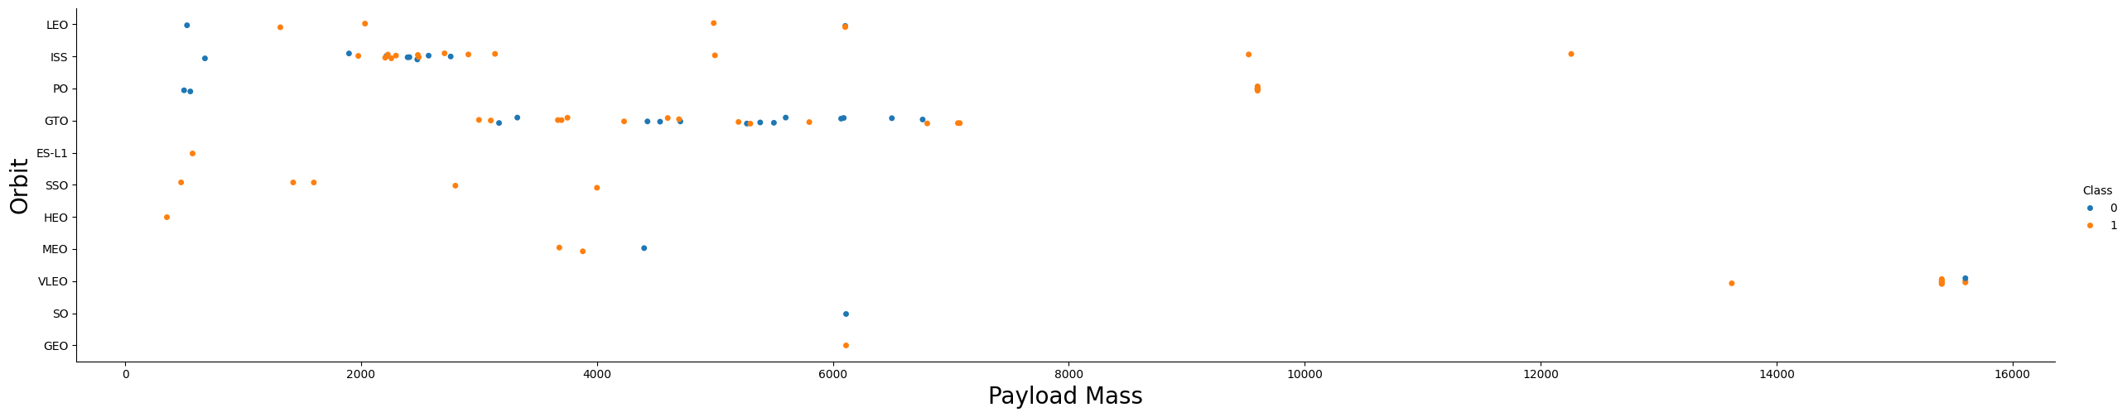
Payload vs. Orbit Type
Blue = failure, orange = success
VLEO had only large payloads, while MEO, SSO, HEO had relatively small payloads
GTO had a mix of success/failures for both small and large payloads
LEO/SS had more success with larger payloads

Slide 23
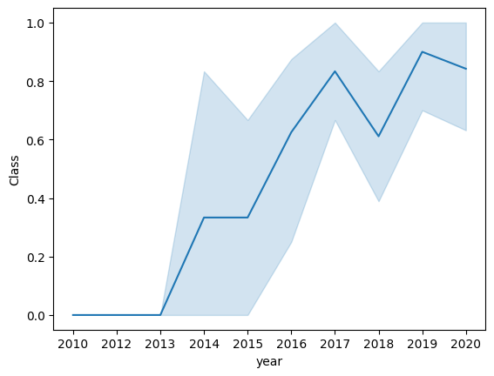
Launch Success Yearly Trend
No success until 2013
2013-2015 shows increasing success but large variance
Around 2017 success leveled out and remained above 60%

Slide 24
All Launch Site Names
Find the names of the unique launch sites
CCAFS LC-40
VAFB SLC-4E
KSC LC-39A
CCAFS SLC-40
There are 4 unique launch sites

Slide 25
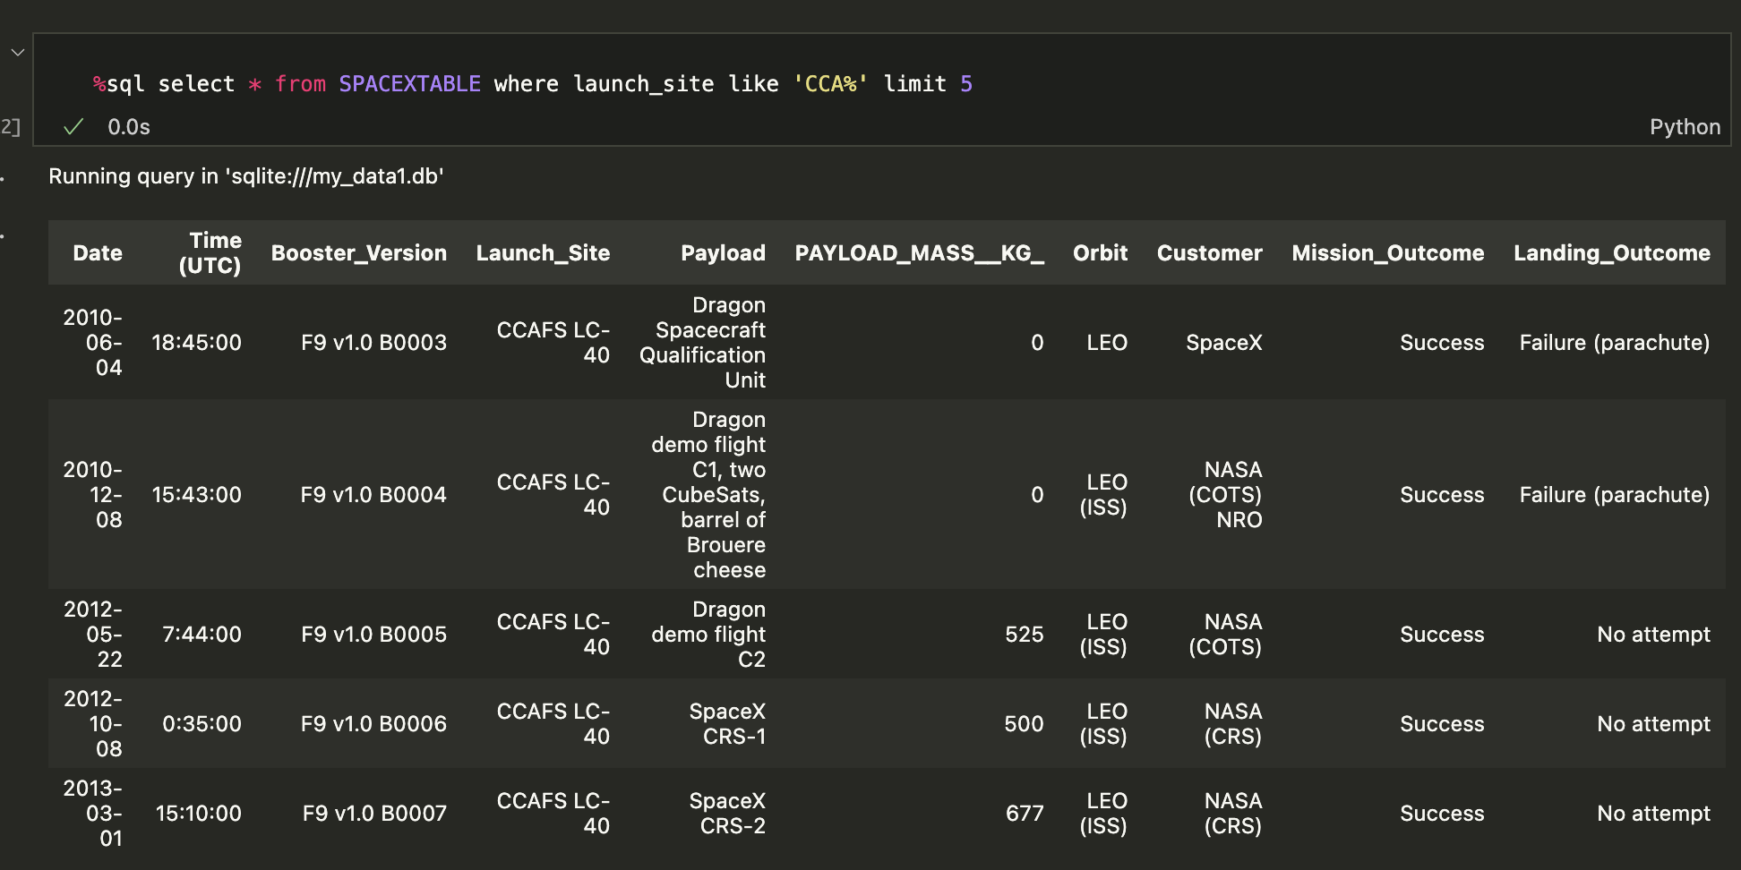
Launch Site Names Begin with 'CCA'
Find 5 records where launch sites begin with `CCA`
Using LIKE "%" and LIMIT to get the correct records

Slide 26
Total Payload Mass
Calculate the total payload carried by boosters from NASA
Using SUM and WHERE to correctly aggregate
45596

Slide 27
Average Payload Mass by F9 v1.1
Calculate the average payload mass carried by booster version F9 v1.1
Using AVG and WHERE to correctly aggregate
2928.4

Slide 28
First Successful Ground Landing Date
Find the dates of the first successful landing outcome on ground pad
Using
where landing_outcome = 'Success (ground pad)'
order by Date ASC limit 1
2015-12-22

Slide 29
Successful Drone Ship Landing with Payload between 4000 and 6000
List the names of boosters which have successfully landed on drone ship and had payload mass greater than 4000 but less than 6000
F9 FT B1022
F9 FT B1026
F9 FT B1021.2
F9 FT B1031.2
Using
distinct Booster_Version
where landing_outcome = 'Success (drone ship)' and payload_mass__kg_ between 4000 and 6000

Slide 30
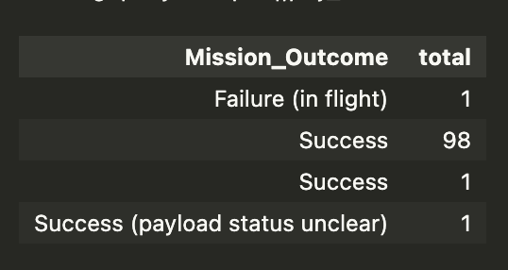
Total Number of Successful and Failure Mission Outcomes
Calculate the total number of successful and failure mission outcomes

Slide 31
Boosters Carried Maximum Payload
List the names of the booster which have carried the maximum payload mass
F9 B5 B1048.4
F9 B5 B1049.4
F9 B5 B1051.3
F9 B5 B1056.4
F9 B5 B1048.5
F9 B5 B1051.4
F9 B5 B1049.5
F9 B5 B1060.2
F9 B5 B1058.3
F9 B5 B1051.6
F9 B5 B1060.3
F9 B5 B1049.7
Using subquery to get the max payload, then get distinct booster version

Slide 32
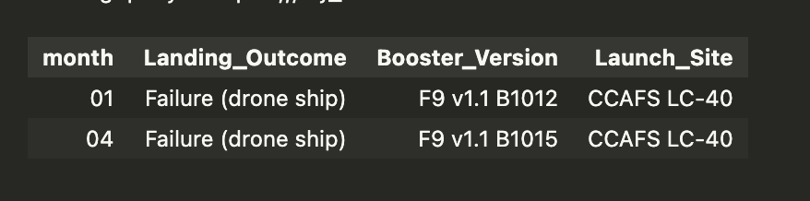
2015 Launch Records
List the failed landing_outcomes in drone ship, their booster versions, and launch site names for in year 2015
Using WHERE landing_outcome = 'Failure (drone ship)' and substr(Date,0,5)='2015'

Slide 33
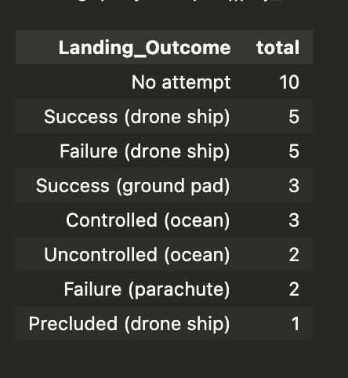
Rank Landing Outcomes Between 2010-06-04 and 2017-03-20
Rank the count of landing outcomes (such as Failure (drone ship) or Success (ground pad)) between the date 2010-06-04 and 2017-03-20, in descending order
Using
Count (landing_outcome) as total
Group by landing_outcome

Slide 34

Section 3

Slide 35
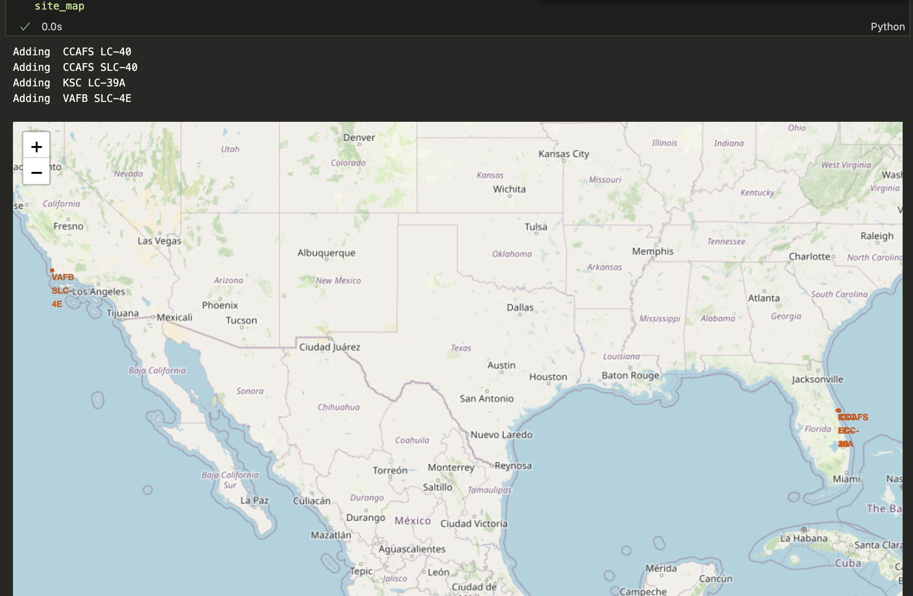
Launch Site Locations
Each marker is a launch site location

Slide 36
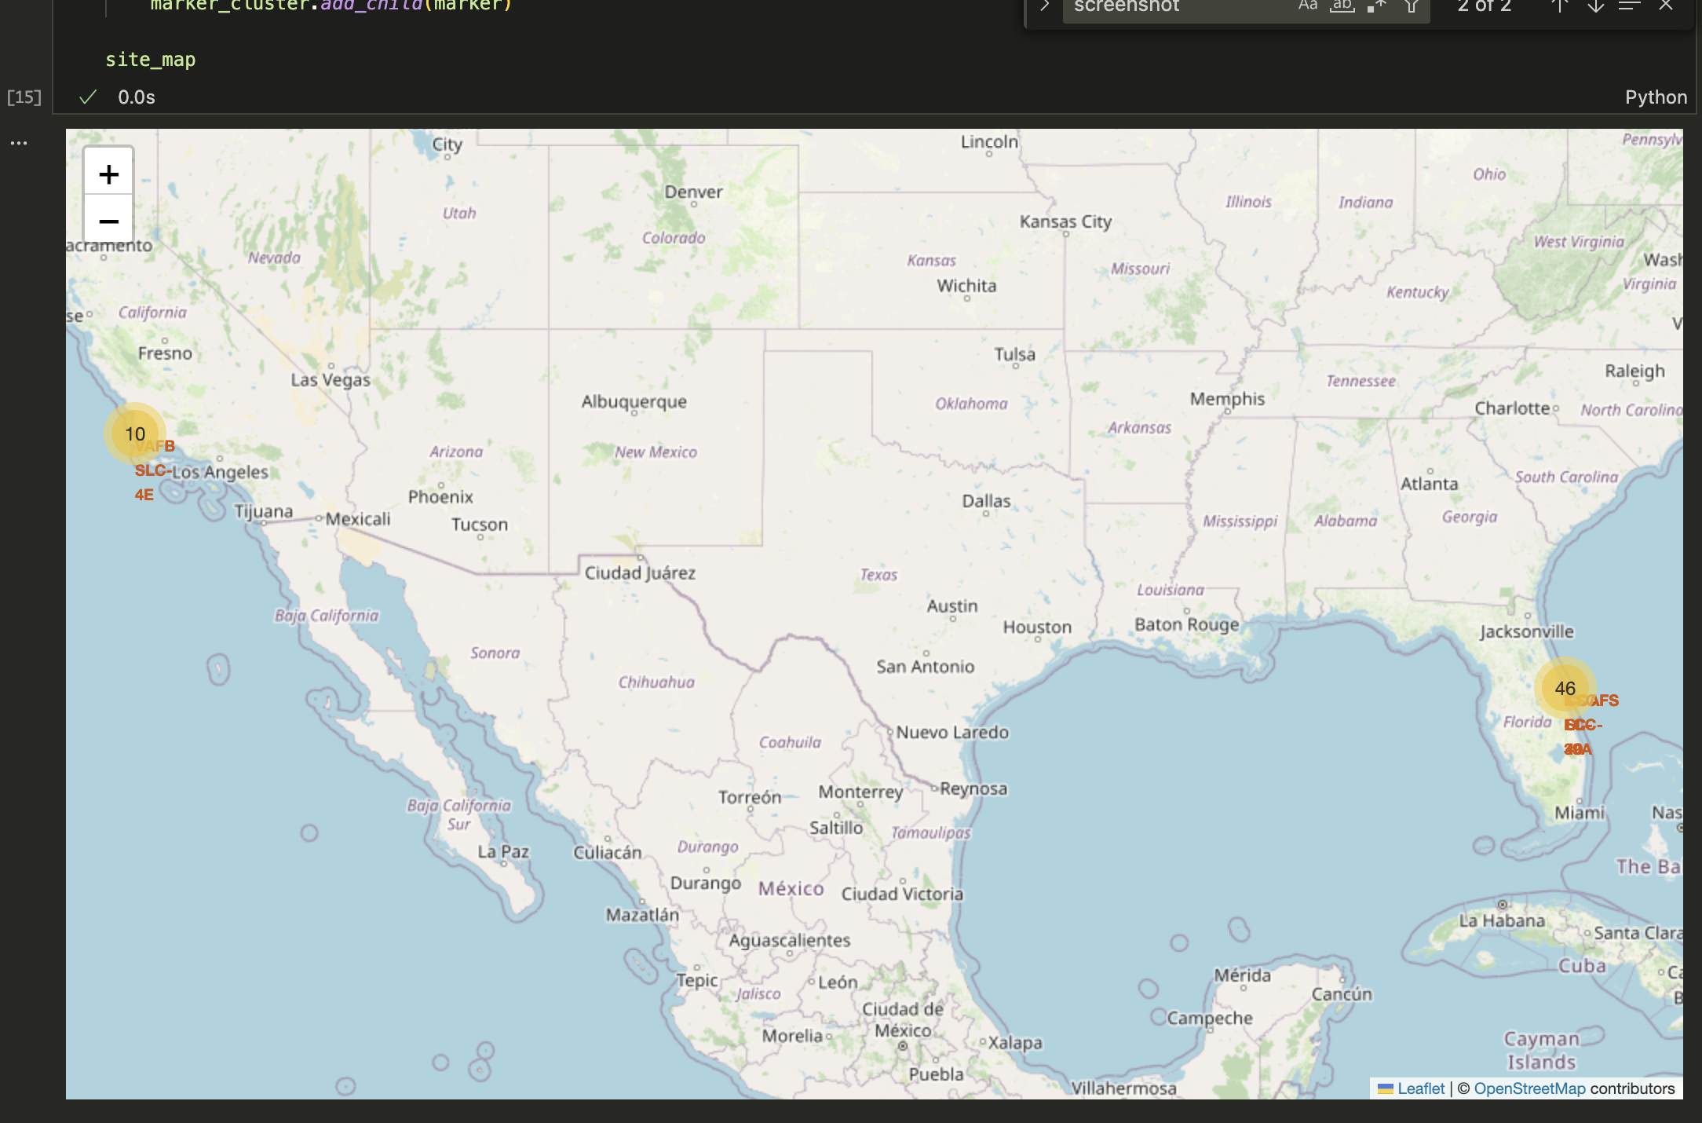
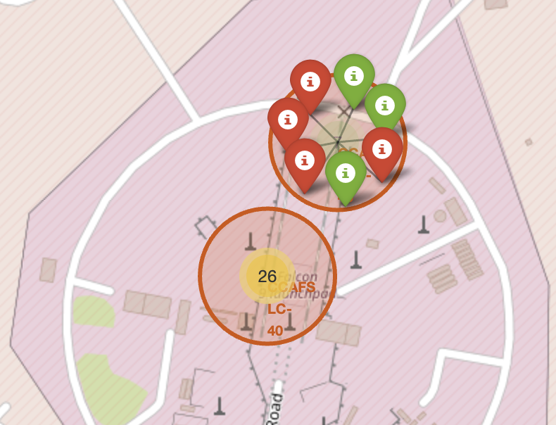
Launch Outcomes
Each launch site is marked
There is a Cluster of markings for each site that shows the outcomes of each individual launch

Slide 37
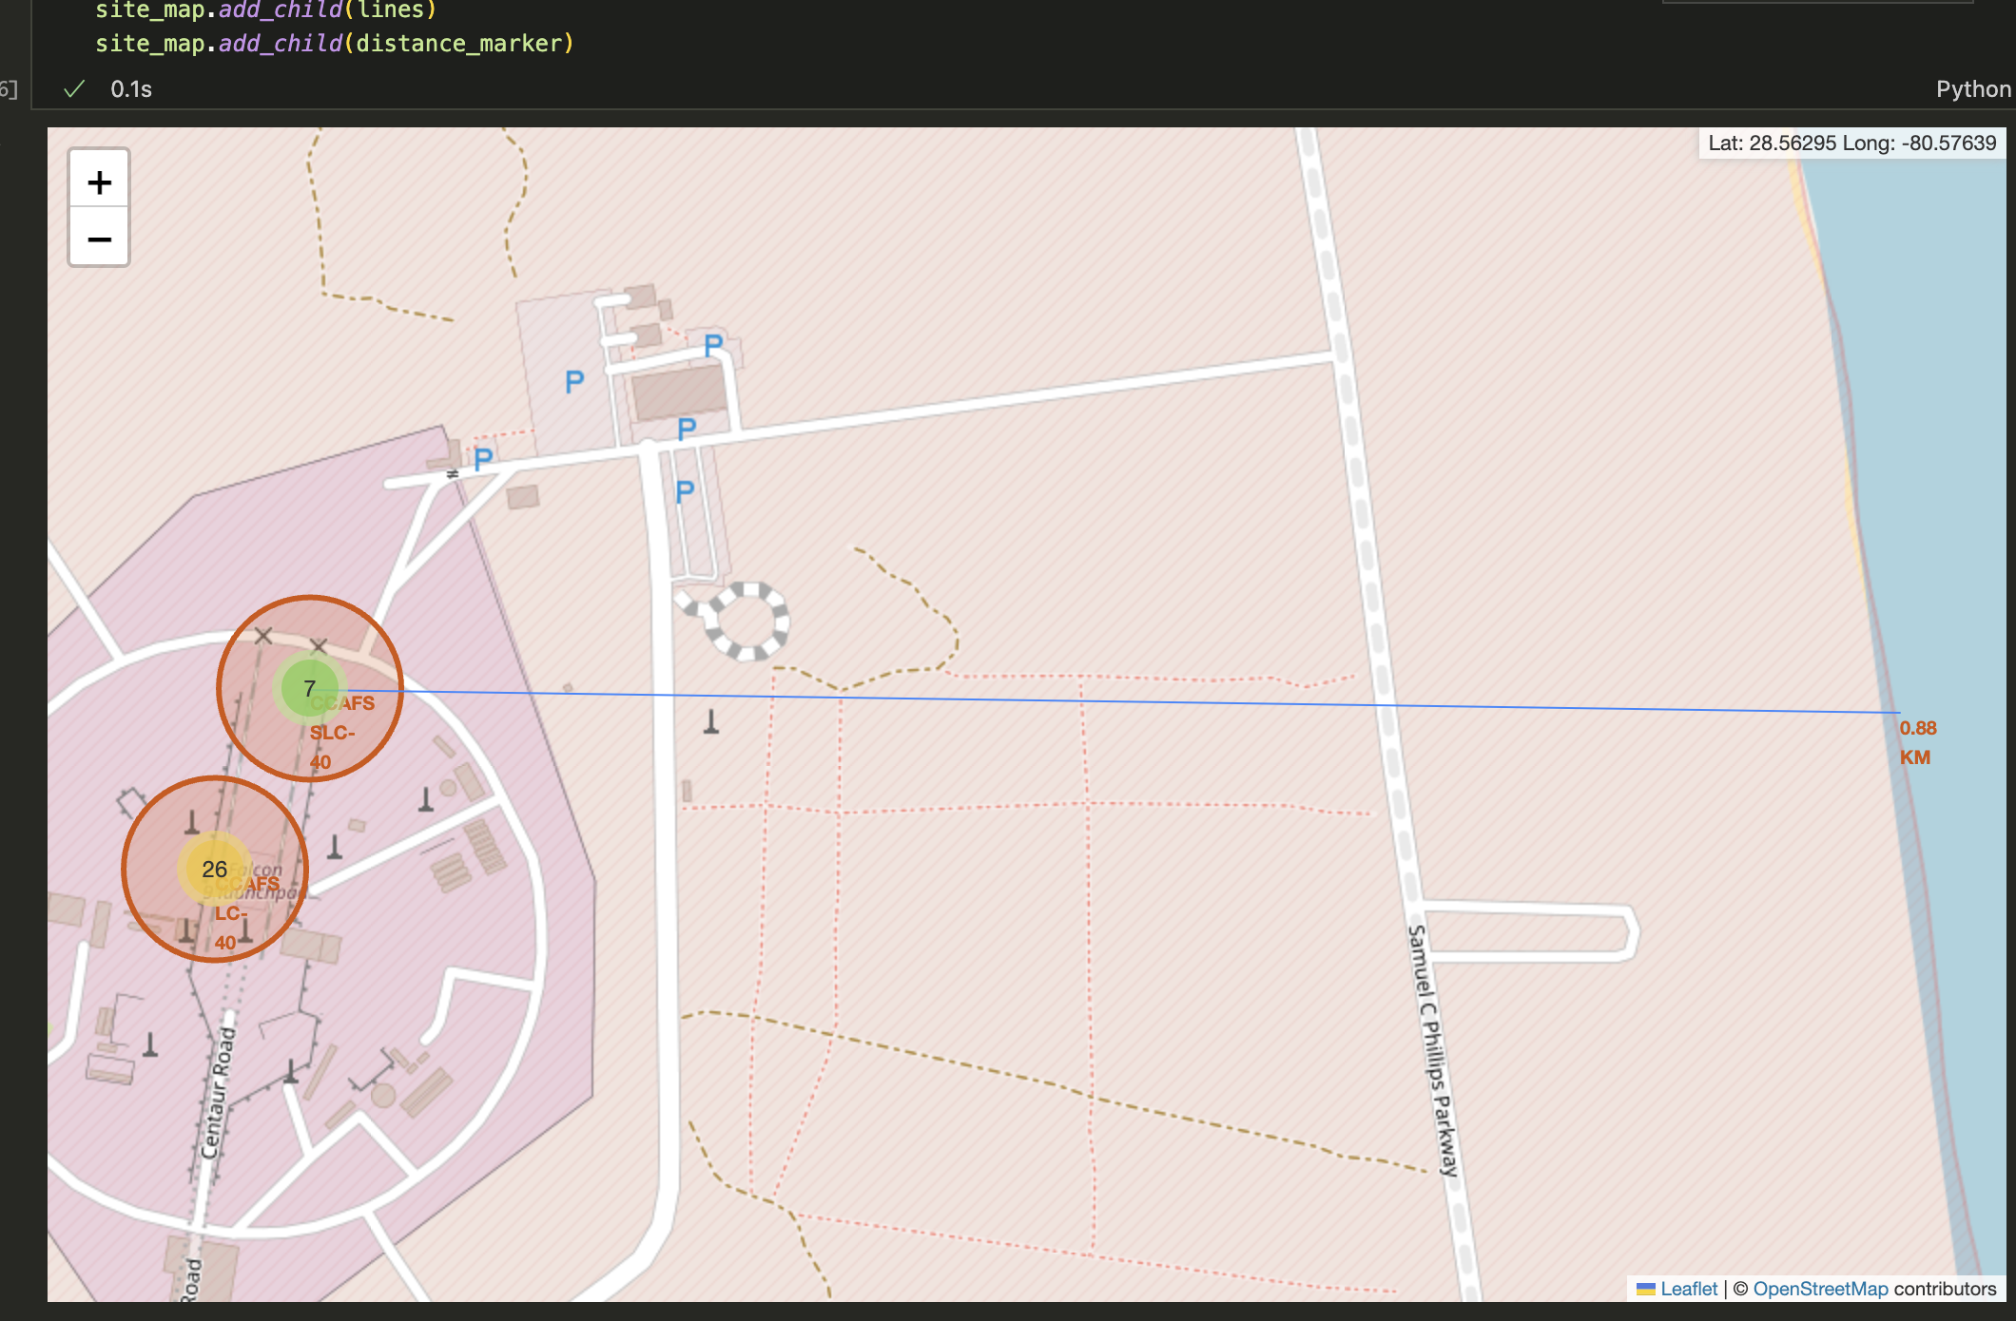
Distance To Coast
A marking that shows a spot on the coast
Plus a line that shows the distance between the launch site and the coast

Slide 38

Section 4

Slide 39
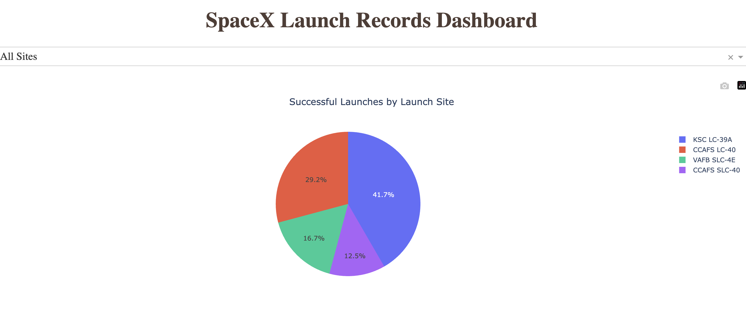
<Dashboard Screenshot 1>
The dropdown has "All Sites" selected
The pie chart shows Successful launches for all sites

Slide 40
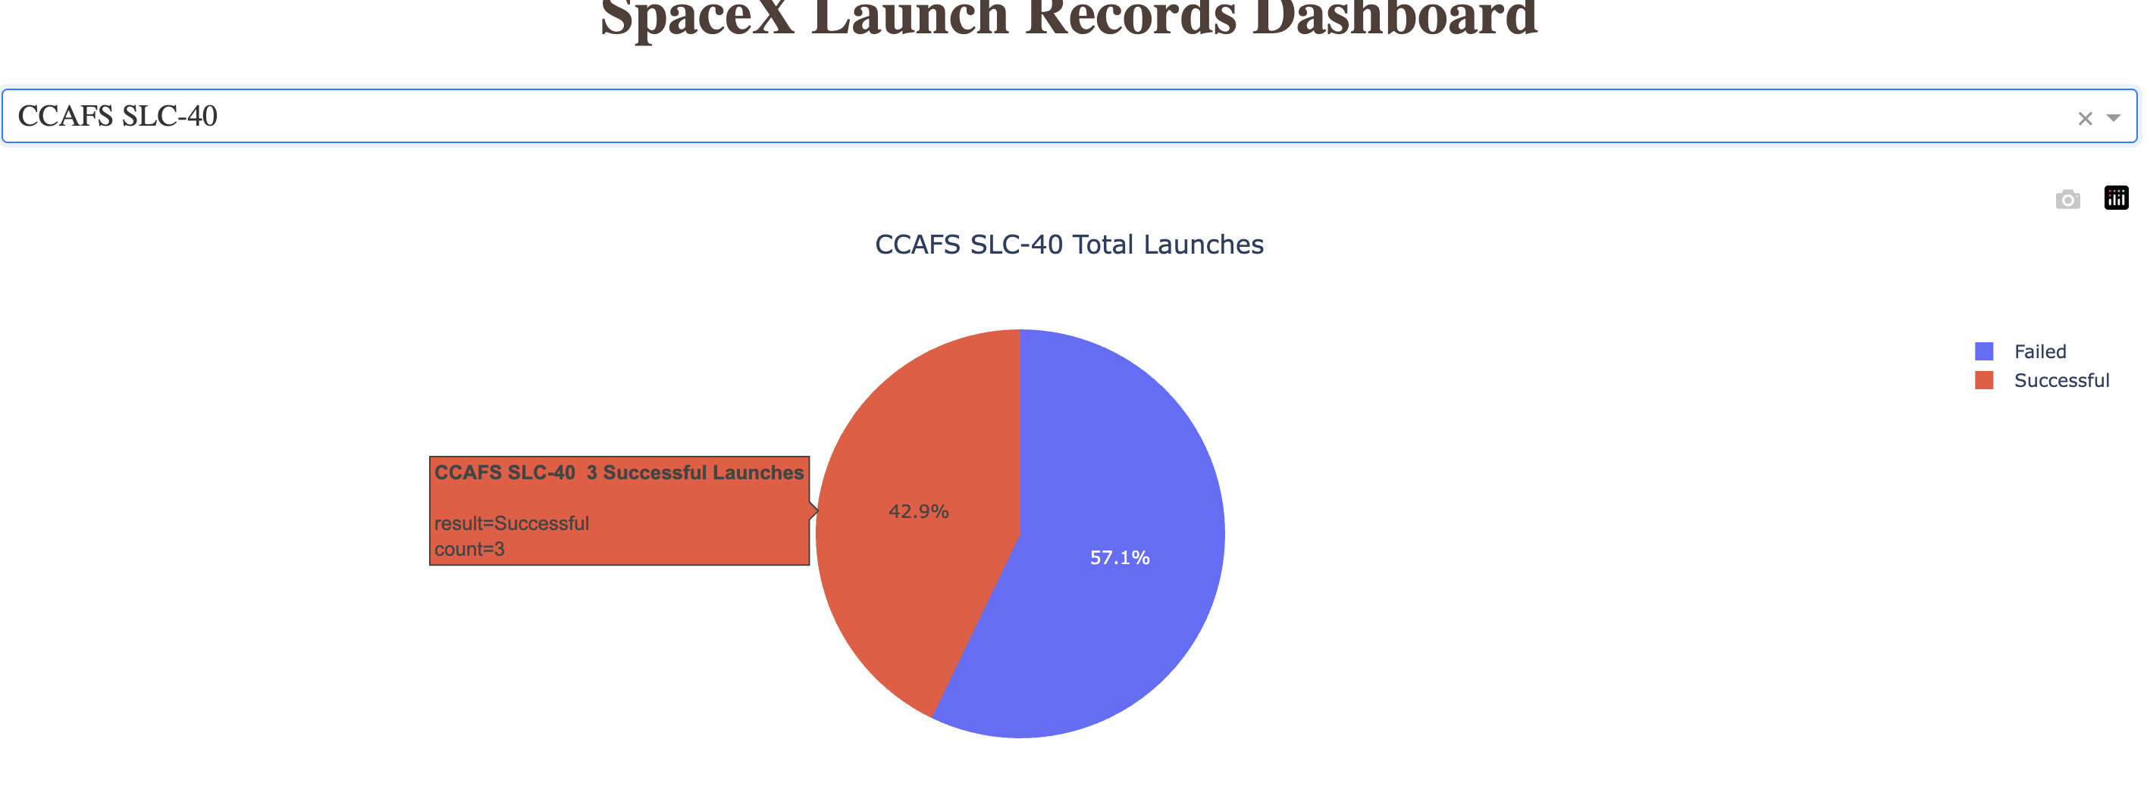
Most successful launch site
CCAFS SLC-40 has a success rate of 42.9%

Slide 41
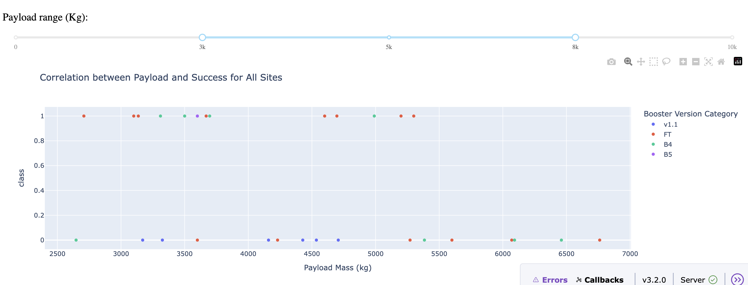
Correlation between Payload and Success for All Sites
Showing payload > 3 and < 8

Slide 42

Section 5

Slide 43
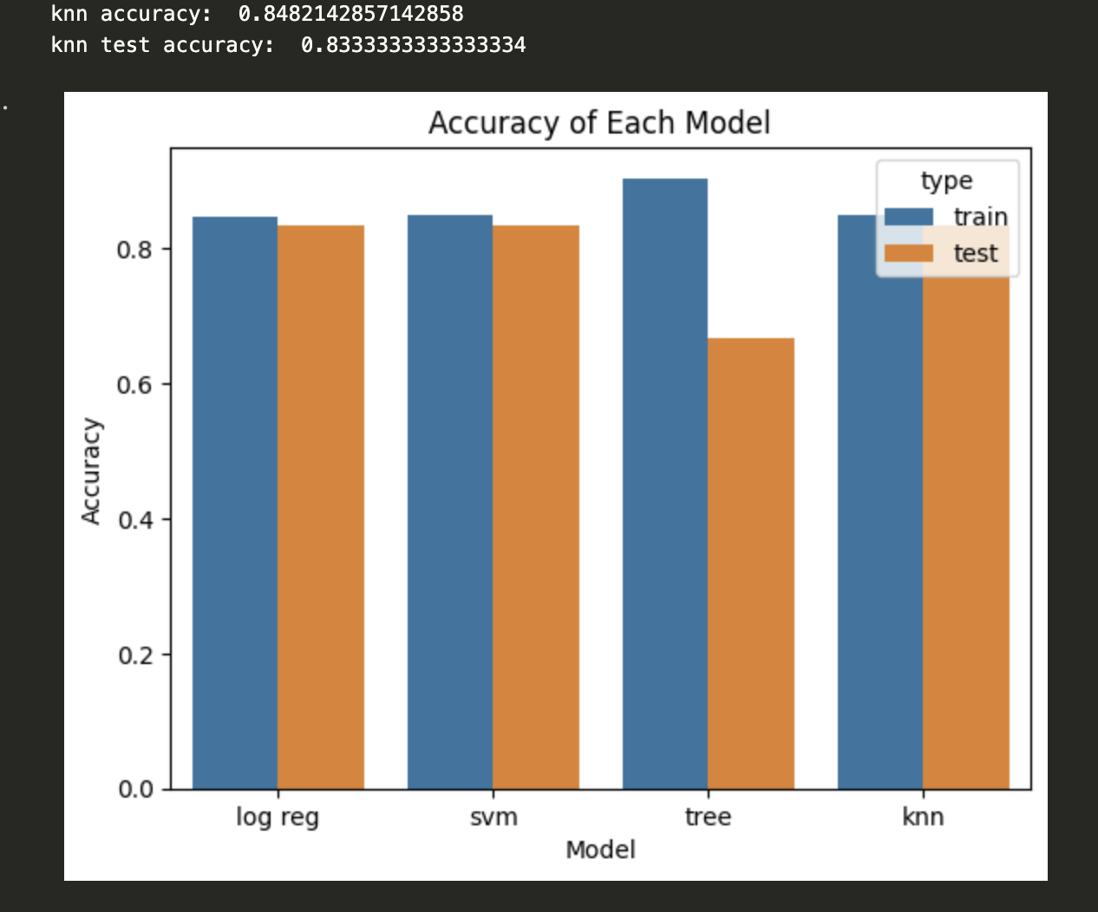
Classification Accuracy
Tree classifier had highest accuracy with training data but not with test data
All other models performed the same

Slide 44
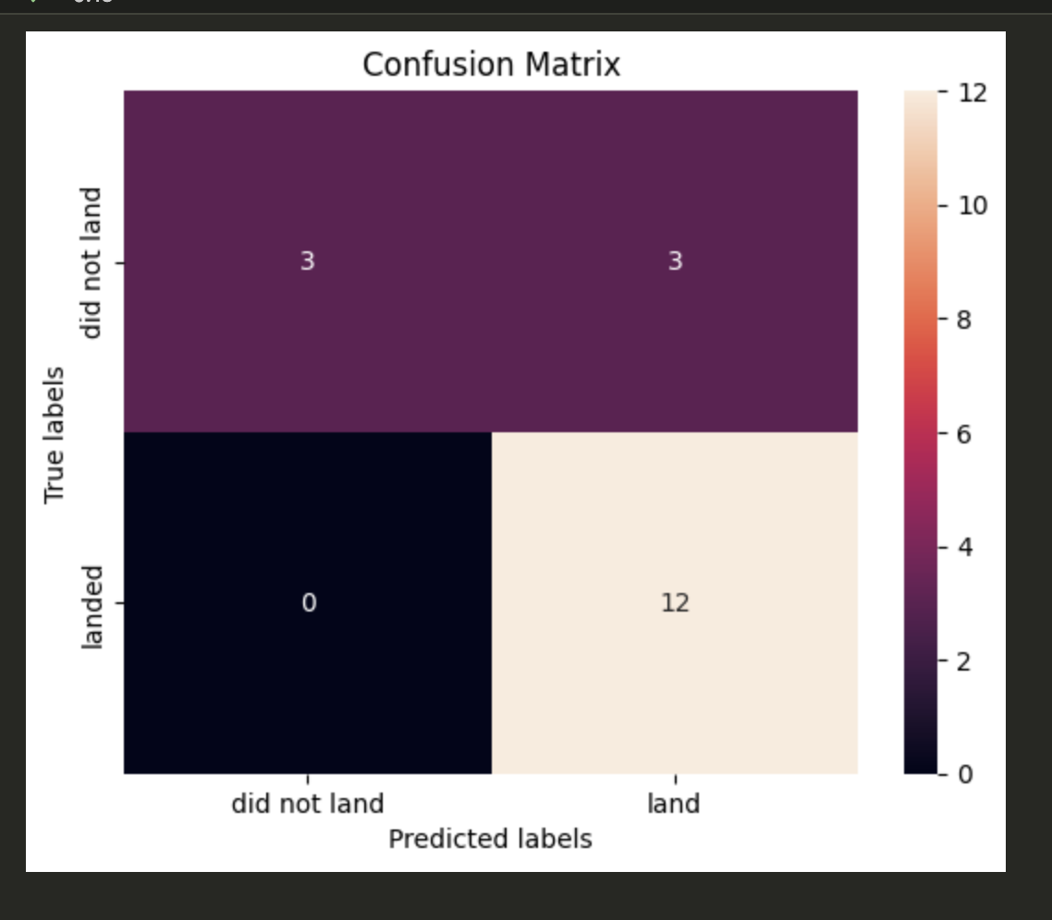
Confusion Matrix
Problem with false positives (predict 'land' but actually 'did not land')

Slide 45
Conclusions
Most of the models were pretty good at predicting.
Tree was bad
Problem with false positives

Slide 46
Appendix
Include any relevant assets like Python code snippets, SQL queries, charts, Notebook outputs, or data sets that you may have created during this project

Slide 47


